Slide 1
Power! Or … Responsibility? Of Attorney
Presentation by Doris W. Gelbman, Gelbman Law PLLC
For VCPEA Annual Conference
May, 2017, Virginia Beach

Slide 2
Let’s Play… “Who” “What” “Where” “When” & “How”
Who -
Grant’s a PoA,
acts under PoA
Accepts a PoA
What -
kind of PoA
Authority does it Grant
What has to be in it
Legal Requirements to Execute
Where –
legal authority conferred
is it accepted
When –
effective
should it be used;
being MIS-Used

Slide 3
The Who of Powers of Attorney
The Principal (‘-pal – your friend gives one) grants Power of Attorney
Must be over 18
Must have sufficient mental capacity to grant POA (more on this later…)
The Agent is the person who receives the Power of Attorney – or in my view, accepts Responsibility of Attorney
Also over 18 and sufficient decision making capacity, otherwise no eligibility criteria
There is no person called “POA”
Incorrect to refer to a Guardian or Conservator as “the POA” nor is any other person who may have some legal responsibility or authority to act.
No one is legally authorized Agent without legal authority - not parent, guardian, adult child

Slide 4
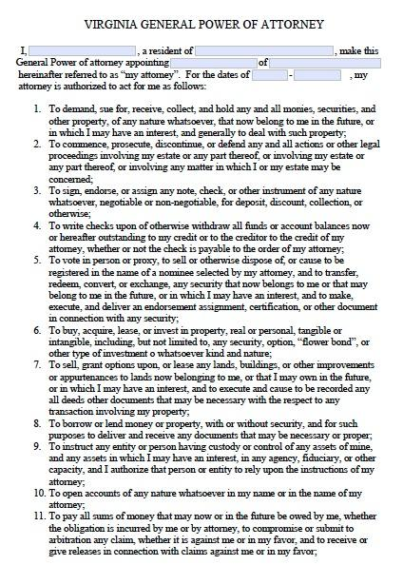
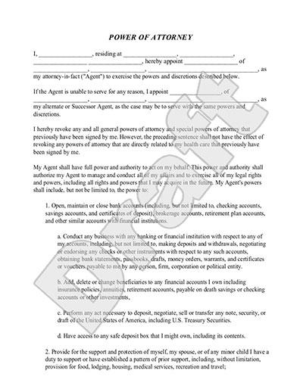
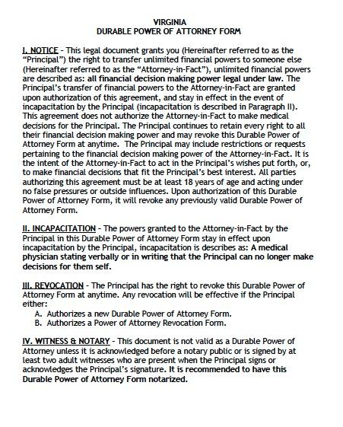
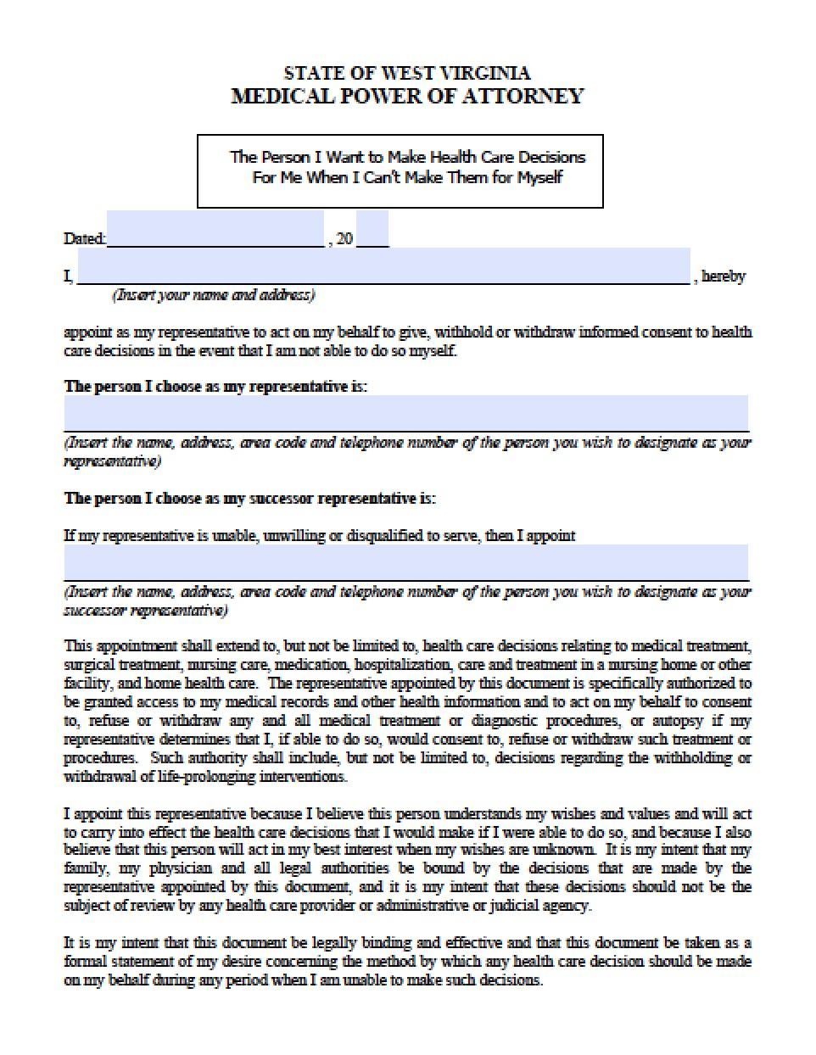
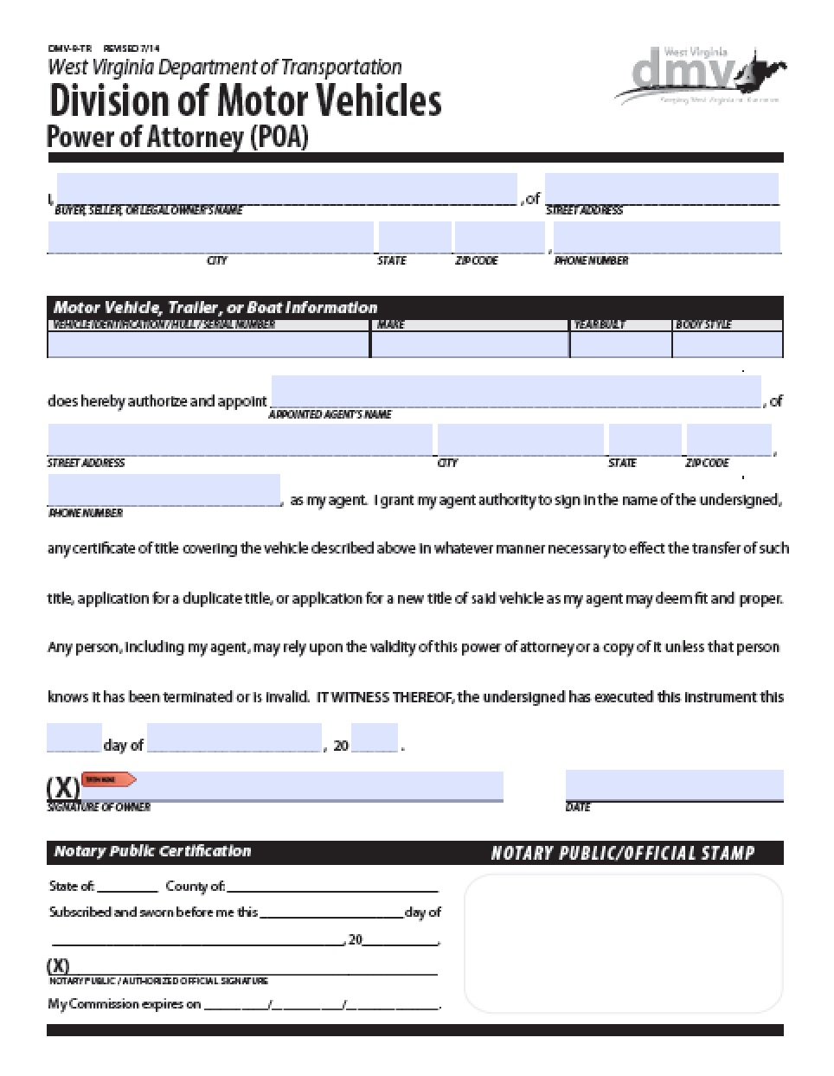
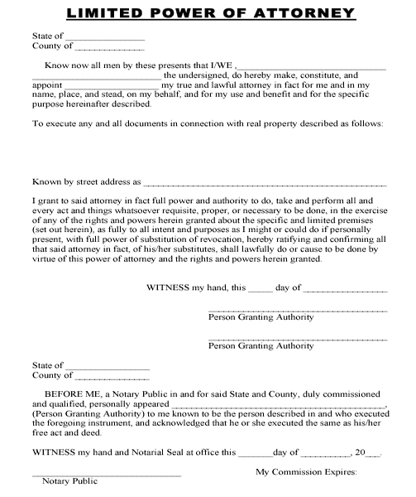
What is a POA?
Legal authority granted by Principal (or “Declarant”) to another, an Agent, who is then authorized to act on behalf of, and in the interest of Principal
Flavors of PoA
General
Durable
Healthcare
Springing
Limited
Special
Property
Financial

Slide 5
What…
Authority does it Grant – read the document!
What has to be in it - differs!
see also Uniform Power of Attorney Act (UPOAA) for mandatory specific grants of authority (e.g. power to sell real estate, power to sue, power of appointment)
Legal Requirements to Execute
May be different state to state
In Virginia: General POA – NO witnesses required, only notary
In Virginia Healthcare POA – NO notary – two witnesses
No agreement required by Agent! (not a bad idea though)
Requisite mental capacity of Principal

Slide 6
What – Mental Capacity for POA
DIFFERENT from legal capacity required to make a Will – Will has relative “low” capacity bar – understands what they got and who its going to.
DIFFERENT from “mental competency” - a term used to determine who is “competent” to stand trial
Mental Capacity sufficient to execute a POA is the same as capacity required to sign a contract.
Capacity to make informed decisions in their own best interest and understand the consequences thereof.

Slide 7
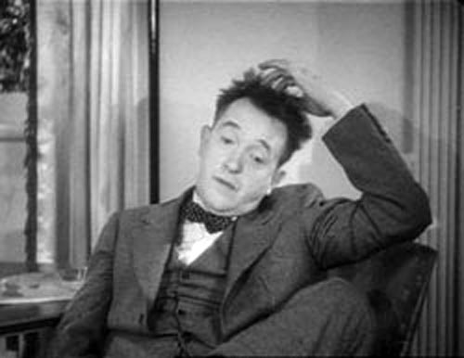
Momentary frolic back to “Who” Capacity
Who has capacity?
Virginia presumption is any adult over 18 has legal mental capacity unless s/he legally deemed otherwise
Who can determine?
Medically – default is is two licensed doctor’s (or one psychologist)
Legally – A robe (Judge or Magistrate)
When drafting POA, who is responsible for assessing principal’s capacity?
????
Lawyer drafting?
Doctor?

Slide 8
Example of one who LACKS Mental Capacity
Normal ‘looking’ adult has a developmental disability
Goes to car lot, picks out car
Hands $1500 to car salesman, says he wants the red Mustang
Salesperson has contract drawn up
Buyer signs contract and drives off with new, shiny red Mustang
Buyer, although they could read, and sign name, had no understanding they are now obligated make $349/month car payment.
Buyer believes he bought & paid for the car.
Has no understanding that the consequences are likely to be: car will be re-possessed, buyer has no wheels and credit damaged

Slide 9
Back to What – more on Capacity
Always ask, “Capacity to do WHAT?” We are concerned with decision making:
What’s for breakfast
What to wear
drive
Have drug treatment w/ potential for side effects
Take part in clinical research
OK to own guns
Make an investment
Then what are the consequences – does principal understand the them?
If it requires “Informed Consent” – then it requires sufficient Mental Capacity to make that decision.

Slide 10
Where…
To get a POA
Lawyer
Form at Staples
Download from Legal Zoom
Medical POA from 100-zillion medical and online sources Dr. or other Medical Provider
Medical POA not to be confused with POLST/POST or DNR (both are doctor’s orders)
Legal authority honored – In what setting?
Financial – banks, brokers, bill paying, starting & stopping services
Legal – real estate transactions, ability to contract, sue, collect debts
Healthcare – anything to do with the “person” where admitted, treatment options
Limited to specific circumstances (e.g. for specific real estate transaction or to deal with a particular creditor)

Slide 11
Where…
Legal authority and code related to Powers of Attorney GENERAL, financial, property – Stuff –
Virginia’s implementation of the Uniform Power of Attorney Act (UPOAA): Virginia Code §64.2-1600 et. seq.
UPOAA specifically excludes applicability in a several circumstances – including:
§ 64.2-1601. Applicability.
This chapter applies to all powers of attorney except:
[…]
2. A power to make health care decisions;

Slide 12
Where
Healthcare POA (HCPOA)
usually part and parcel of an Advanced Medical Directive.
HCPOA is NOT part of a General (financial) POA even if the language in the POA says otherwise (they often do).
Authority and rules regarding HCPOA is regulated under the Health Care Decisions Act which is encoded at Va. Code § 54.1-2981
Unlike General POA under UPOAA, Healthcare POA has a “default” provision when no HPCOA exists!

Slide 13
Brief Detour Back to “Who”…
§ 54.1-2986. Procedure in absence of an advance directive […]
A hierarchical list:
guardian
spouse (unless divorce has been filed)
adult child
parent
adult siblings
Any other relative of the patient in the descending order of blood relationship; or
Any adult! Unless it involves the withholding or withdrawing of a life-prolonging procedure; and excludes any director, employee, or agent of a health care provider currently involved in the care of the patient.

Slide 14
Where
is POA accepted
See also UPOAA for general POA
Healthcare – if properly executed – any medical provider or agency that needs “informed medical consent” (e.g. pharmacy, health insurance)
Is it found?
Gathering dust in Safety Deposit box
Copies with Fiduciaries (agent or other trusted advisors/family members
Recorded at Circuit Court
Online in Central Registries (e.g. VDH Registry for AMD/HCPOA) or other online registries

Slide 15
When
effective ?
By “default” it is effective immediately upon signing
Can create “springing” POA that becomes effective upon certain event occurring, usually loss of capacity
(if this is the case, should define how capacity is determined)
should it be used
HCPOA – only upon determination of incapacity
POA – only in Principal’s best interest and at Principal’s direction unless/until Principal is not able.
being MIS-Used – anytime it is not in Principal’s interest or against Principal’s will (if sound of mind)

Slide 16
How….
Legally (properly) acquired and executed but may misuse by unintentionally failing to
Keep detailed records
Maintain separate accounts (must not commingle funds)
Spend or act only for best interest of principal

Slide 17
How….
Legally (properly) acquired and executed may misuse by
Wrongly dissipating assets or property (“waste”)
Using money or property for benefit of self or another (not principal) or ‘self dealing’
Neglect – accepting authority to act and failing to do so
Abandon – similar to Neglect – but abandons altogether, not just certain acts

Slide 18
How….
Improperly/illegally acquired
Thru “undue influence”
Threat/extortion
Fraudulently (incapacited person or forgery)
Improperly/illegally used – steals or dissipates assets

Slide 19
The issue of “Undue Influence”
Undue Influence defined:
one person taking advantage of a position of power over another person. The unequal power between the parties may corrupt one party's consent if they are unable to freely exercise their independent will.
May still have requisite mental capacity
Principal’s ability to resist is overcome
Principal’s decision making ability is overpowered
Is not able to legally consent to granting a POA if subject to undue influence.

Slide 20
The issue of “Undue Influence”
Undue Influence by itself
Is NOT a crime
Is not a legal cause action – in civil proceedings
It is the means by which crimes and such things as breach of fiduciary might be accomplished.
e.g. – Joe Adult Child withholds mother’s food and water. While she is weak and vulnerable, Joe gets mother to sign a POA. She has the requisite capacity, but is unable to assert her will to refuse.
It is next to impossible to prove.

Slide 21
What Are You Doing About It?
Criminal Context
Larceny
Embezzlement
Fraud
Wire Fraud
Credit Card Fraud
Computer Crimes
Civil Context:
Breach of Fiduciary Duty
Conversion
Breach of Contract
Fraud by Undue Influence
ASK: What is the REMEDY?

Slide 22
Can They Be Sued? (Civil Complaint)
Police – especially in instances where a POA has been used…
“That’s a Civil problem, you need to go get a lawyer and sue them.” …
Or…
“You ‘consented’ we can’t prosecute
That may not be entirely accurate

Slide 23
Can They Be Sued? (Civil Complaint)
Barriers to civil litigation:
Who will pay cost? Victim probably cannot.
2014 Virginia law allows for recovery of attorneys-fees in cases
§ Va. Code 8.01-221.2 Action for rescission of deed or other instrument on grounds of undue influence; attorneys fees
In any civil action to rescind a contract or other instrument, may recover attorneys fees and litigation costs if court finds, by clear and convincing evidence, that the instrument was obtained by fraud or undue influence

Slide 24
Can They Be Sued? (Civil Complaint)
Barriers to civil litigation:
For what? What is the “cause of action”?
Virginia law now allows for a demand for “Accounting” by Agent/Fiduciary (Executor, Trustee)
Allows “discovery” without filing a lawsuit – no subpoena duces tecum or other court procedures.
See Virginia Code 64.2 Duties of Agent – sub-paragraph H and I – may demand accounting going back as far as 5 years.
Follow the money!

Slide 25
Can They Be Sued?
Barriers to civil litigation:
Victim may lack the capacity to engage an attorney or bring suit.
The Agent under POA (who can) is probably the defendant.
Requires a different judicial proceeding
Victim needs a Guardian to bring the civil suit.

Slide 26
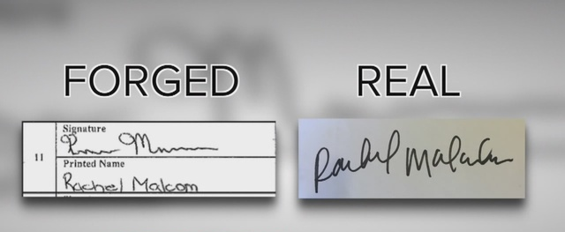
Can They Be Sued?
Barriers to civil litigation:
Victim is incapacitated. “Bad” witness, lack of memory cannot provide credible testimony.
Seek other evidence – documents, bank clerks, other witnesses
#1 reason police/commonwealth won’t want to bring a criminal case

Slide 27
Is It a Crime?
Some – not many – cases have clear cut criminal elements – outright theft or blatant forgery.
But there are other crimes – most commonly with a POA – look for embezzlement.
Embezzlement is defined in Va criminal code at § 18.2-111
property is converted, used, concealed or disposed of with the intent to permanently deprive owner of the use thereof,
property had been entrusted to the defendant by through employment, office or position.
is a felony theft crime if >$200.

Slide 28
How Investigated as a Crime?
Direct report to Law Enforcement
DSS/APS requirement to report to law enforcement:
In 2016 new statute enacted:
Upon receipt of a report or during an adult protective services investigation of suspected financial exploitation of an adult who is 60 years old or older or incapacitated in which financial losses to such adult resulting from the exploitation are suspected to be greater than $50,000, the local department of social services or adult protective services hotline shall immediately refer the matter to the local law-enforcement agency for investigation.
Amended Statute – effective July 2017 – NO $$ Limit

Slide 29
Some measures I recommend
If presented with a POA – READ THE DOCUMENT. What is it being presented for? Does the document actually empower the Agent to do that?
Make sure it is properly executed (signatures, notary, witnesses etc.)
Take a few minutes to look at the Virginia implementation of the UPOAA – it tells you what is and isn’t acceptable.
Google: Virginia Code § 64.2-1600
If you suspect a POA is being misused, contact an attorney to review the situation – if you are DSS – your County/Municipal attorney should be able to help
If you draft and execute POAs….

Slide 30
Some Practices I Recommend for ATTORNEYS
Ensure
Make
Avoid
Meet
Give
Include
Explain
Ensure that the PRINCIPAL has initiated the request for the POA
Don’t do work for principal upon Agent’s request!
reasonable inquiry as to PRINCIPAL’S mental capacity. If you have any doubt at all, get certification from P’s doctor
Record your assessment and conclusion(s) to your file for later reference in the event ever challenged
any possibility of Undue Influence
with the Principal alone – make others leave the building to ensure not even the subtlest hint of undue influence or interference
detailed but simple WRITTEN instructions
what to do with the documents.
What to do with originals,
to whom to give copies.
Needs recording?
Central Repository?
in the document
list of Agent’s duties. If possible review those with Principal and Agent explaining Fiduciary RESPONSIBILITY (not Power!)
Consider getting Agent to sign acknowledgement
how and when to effectively REVOKE a POA
Notice in writing
To ALL 3rd parties

Slide 31
Power of Attorney gives someone legal authority to do things ONLY in the best interest of their principal
Agent has no “Power over…” anyone or anything
Agent has a “Responsibility to…” Principal
Under the law, Agent has a very high level of responsibility called a “Fiduciary Duty” a position of extraordinary trust.
incudes the duty of loyalty
and a duty of care.
Agent can be held liable - sued - for Breach of Fiduciary Duty and win money damages or restitution

Slide 32
Combatting Misuse and Exploitation with POA
Use of Multi-Disciplinary, Multi-Jursidiction Resources working together
June 2016 – Launched Jefferson Area Coalition Against Elder Abuse - JACEEA
Law Enforcement – Cville and AC Police Department, Sheriffs Dept, VSP and FBI
Prosecutors – Albemarle and Cville Commonwealth’s Atty; Federal DoJ, OIG and Va. A.G. MFCU
Social Services/APS
Civil Attorneys, Private, Legal Aid and County/Municipal Attorneys
Ombudsman – Advocate for folks in Long Term Care settings
Banks/Financial Advisors
Care Providers

Slide 33
Combatting Misuse and Exploitation with POA
Use of Multi-Disciplinary, Multi-Jursidiction Resources working together
Memorandum of Understanding (MOU) for all team members
Wider Group meets Quarterly face to face – case discussion to assist on active investigations, case review to see what’s working, what’s not.
Training, training, and training – VBA panel, How to Investigate/Prosecute
Electronic presence (Google Groups) to exchange information regularly (no spamming!)
Smaller teams meet as needed.
trategize on individual cases, e.g. APS caseworker, investigating officer, commonwealth’s attorney, ombudsman, private attorney and any other relevant discipline. Where possible, get waiver of confidentiality from victim so information may be freely exchanged

Slide 34
Combatting Misuse and Exploitation with POA
Use of Multi-Disciplinary, Multi-Jursidiction Resources working together
Portal to JACEEA is via APS
When potential criminal activity is suspected, APS reports to law enforcement and Commonwealth’s attorney
Where appropriate, civil attorney or other agency participates.
Case monitored by C.A. for possible escalation and follow up

Slide 35
Success Stories – Begin Trickling In!
ECDC provider lack of care results in loss of a leg due to severe neglect. Billed Medicaid for not provided. Small $$, big Medicaid Fraud. Provider convicted of $6,000 fraud against DMAS. DoJ, Va. A.G. MFCU, CMS OIG, Albemarle County DSS all worked together to convict. Brief jail time, Restitution, probation, loss of license.
Cville PD and APS investigate contractor building ‘fences’ – (and other theft crimes) convicted. Jailed pending sentencing; CA expects 8 years jail time, restitution.
Daughter/caregiver investigated for fraud, embezzlement, forgery other financial wrongdoing still pending, but removed access to funds, placed new fiduciary to restore and protect victim.

Slide 36
Questions? Comments? Your War Stories?
Doris W. Gelbman
GELBMAN LAW PLLC
Center for Elder Services
525 Meade Ave.
Charlotteville, VA 22902
www.gelbmanlaw.com
Telephone ( 434) 906-7022
Email: dwgelbman@gelbmanlaw.com
Exclusively practicing Elder Law!

